Slide 1
SWE 4101
Number System
&
Logic Gates
Lec - 3
Based on: Computer Fundamentals: Pradeep K. Sinha …

Slide 2
Number Systems
Two types of number systems are:
  Non-positional number systems
  Characteristics
    Use symbols such as I for 1, II for 2, III for 3, IIII for 4, IIIII for 5, etc
    Each symbol represents the same value regardless of its position in the number
    The symbols are simply added to find out the value of a particular number
    Difficulty
    It is difficult to perform arithmetic with such a number system
  Positional number systems
    Characteristics
    Use only a few symbols called digits
    These symbols represent different values depending on the position they occupy in the number
    The maximum value of a single digit is always equal to one less than the value of the base
    The value of each digit is determined by:
      The digit itself
      The position of the digit in the number
      The base of the number system
base = total number of digits in the number system

Slide 3
Decimal Number System
Characteristics
A positional number system
Has 10 symbols or digits (0, 1, 2, 3, 4, 5, 6, 7, 8, 9). Hence, its base = 10
The maximum value of a single digit is 9 (one less than the value of the base)
Each position of a digit represents a specific power of the base (10)
We use this number system in our day-to-day life
Example
2586₁₀ = (2 x 10³ ) + (5 x 10² ) + (8 x 10¹ ) + (6 x 10⁰ )
= 2000 + 500 + 80 + 6

Slide 4
Binary Number System
Characteristics
A positional number system
Has only 2 symbols or digits (0 and 1). Hence its base = 2
The maximum value of a single digit is 1 (one less than the value of the base)
Each position of a digit represents a specific power of the base (2)
This number system is used in computers
Example
10101₂ = (1 x 2⁴) + (0 x 2³) + (1 x 2²) + (0 x 2¹) x (1 x 2⁰)
= 16 + 0 + 4 + 0 + 1
= 21₁₀

Slide 5
Octal Number System
Characteristics
A positional number system
Has total 8 symbols or digits (0, 1, 2, 3, 4, 5, 6, 7). Hence, its base = 8
The maximum value of a single digit is 7 (one less than the value of the base
Each position of a digit represents a specific power of the base (8)
Since there are only 8 digits, 3 bits (2³ = 8) are sufficient to represent any octal number in binary
Example
2057₈ = (2 x 8³) + (0 x 8²) + (5 x 8¹) + (7 x 8⁰)
    = 1024 + 0 + 40 + 7
    = 1071₁₀

Slide 6
Hexadecimal Number System
Characteristics
A positional number system
Has total 16 symbols or digits (0, 1, 2, 3, 4, 5, 6, 7, 8, 9, A, B, C, D, E, F). Hence its base = 16
The symbols A, B, C, D, E and F represent the decimal values 10, 11, 12, 13, 14 and 15 respectively
The maximum value of a single digit is 15 (one less than the value of the base)
Each position of a digit represents a specific power of the base (16)
Since there are only 16 digits, 4 bits (24 = 16) are sufficient to represent any hexadecimal number in binary
Example
1AF₁₆ = (1 x 16²) + (A x 16¹) + (F x 16⁰)
    = 1 x 256 + 10 x 16 + 15 x 1
    = 256 + 160 + 15
    = 431₁₀

Slide 7
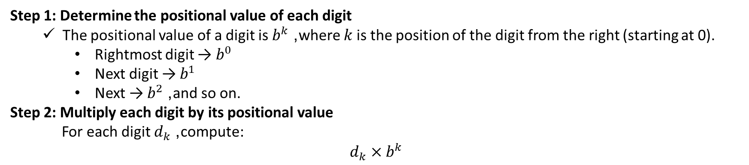
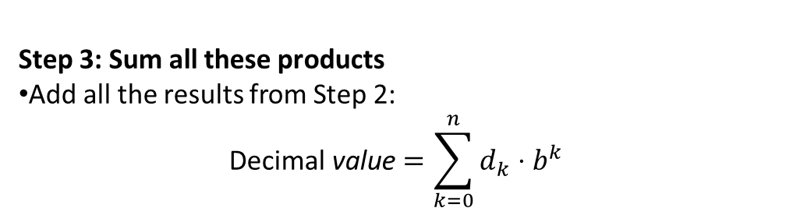
Any Base to Decimal
Suppose we have a number in base $b$(where $b>1$) and we want to convert it to decimal.
Let the number be $d_{n}d_{n−1}…d_{1}d_{0}$, where $d_{0}$is the rightmost digit.
Step 1: Determine the positional value of each digit
  The positional value of a digit is $b^{k}$, where $k$is the position of the digit from the right (starting at 0).
    Rightmost digit → $b^{0}$
    Next digit → $b^{1}$
    Next → $b^{2}$, and so on.
Step 2: Multiply each digit by its positional value
For each digit $d_{k}$, compute:
$$d_{k}×b^{k}$$
Step 3: Sum all these products
Add all the results from Step 2:
$$\text{Decimal} \text{value}=\sum_{k=0}^{n}{d_{k}}⋅b^{k}$$
Example
  4706₈ = ?₁₀
4706₈ = 4 x 8³ + 7 x 8² + 0 x 8¹ + 6 x 8⁰
  = 4 x 512 + 7 x 64 + 0 + 6 x 1
  = 2048 + 448 + 0 + 6
  = 2502₁₀

Slide 8
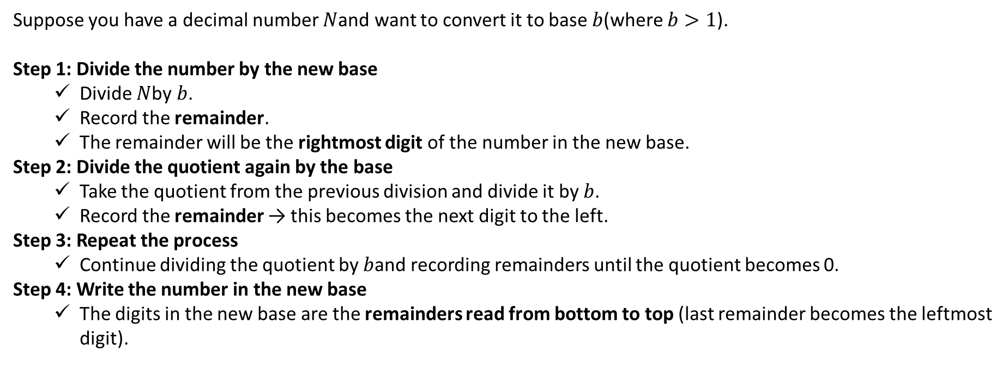
Decimal to Any Base
Suppose you have a decimal number $N$and want to convert it to base $b$(where $b>1$).
Step 1: Divide the number by the new base
  Divide $N$by $b$.
  Record the remainder.
  The remainder will be the rightmost digit of the number in the new base.
Step 2: Divide the quotient again by the base
  Take the quotient from the previous division and divide it by $b$.
  Record the remainder → this becomes the next digit to the left.
Step 3: Repeat the process
  Continue dividing the quotient by $b$and recording remainders until the quotient becomes 0.
Step 4: Write the number in the new base
  The digits in the new base are the remainders read from bottom to top (last remainder becomes the leftmost digit).
Example: ${156}_{10}= ??8$
156÷8=19 remainder 4
19÷8=2 remainder 3
2÷8=0 remainder 2
So, 156₁₀​=234₈​.
remainders from bottom to top: 234

Slide 9
Convert from any base to other base
545₆ = ?₄
Hope you can solve it…..

Slide 10
Shortcut : Binary to Octal
Method
  Step 1: Divide the digits into groups of three starting from the right
  Step 2: Convert each group of three binary digits to one octal digit using the method of binary to decimal conversion
Example
1101010₂ = ?₈
Step 1: Divide the binary digits into groups of 3 starting from right
        001 101 010
Step 2: Convert each group into one octal digit
001₂ = 0 x 2² + 0 x 2¹ + 1 x 2⁰ = 1
101₂ = 1 x 2² + 0 x 2¹ + 1 x 2⁰ = 5
010₂ = 0 x 2² + 1 x 2¹ + 0 x 2⁰ = 2
Hence, 1101010₂ = 152₈

Slide 11
Shortcut : Octal to Binary
Method
  Step 1: Convert each octal digit to a 3 digit binary number (the octal digits may be treated as decimal for this conversion)
  Step 2: Combine all the resulting binary groups (of 3 digits each) into a single binary number
Example
562₈ = ?₂
Step 1: Convert each octal digit to 3 binary digits
        5₈ = 101₂ , 6₈ = 110₂ , 2₈ = 010₂
Step 2: Combine the binary groups
562₈ = 101 110 010
5 6 2
Hence, 152₈ = 101110010₂

Slide 12
Shortcut : Binary to Hexadecimal
Method
  Step 1: Divide the digits into groups of four starting from the right
  Step 2: Combine each group of four binary digits to one hexadecimal digit
Example
111101₂ = ?₁₆
Step 1: Divide the binary digits into groups of 4 starting from right
0011 1101
Step 2: Convert each group into a hexadecimal digit
0011₂ = 0 x 2³ + 0 x 2¹ + 1 x 2¹ + 1 x 2⁰ = 3₁₀ = 3₁₆
1101₂ = 1 x 2³ + 1 x 2² + 0 x 2¹ + 1 x 2⁰ = 13₁₀ = D₁₆
Hence, 111101₂ = 3D₁₆

Slide 13
Shortcut :Hexadecimal to Binary
Method
  Step 1: Convert the decimal equivalent of each hexadecimal digit to a 4 digit binary number
  Step 2: Combine all the resulting binary groups (of 4 digits each) in a single binary number
Example
2AB₁₆ = ?₂
Step 1: Convert each hexadecimal digit to a 4 digit binary number
        2₁₆ = 2₁₀ = 0010₂
        A₁₆ = 10₁₀ = 1010₂
        B₁₆ = 11₁₀ = 1011₂
Step 2: Combine the binary groups
2AB₁₆ = 0010 1010 1011
2 A B
Hence, 2AB₁₆ = 001010101011₂

Slide 14


Convert a Fractional Decimal Number to Binary
Let your number be:
$$N=\text{Integer} \text{part}+\text{Fractional} \text{part}$$
For example, $N=12.625$.
Step 1: Convert the integer part to binary . Use repeated division by 2, just like with whole numbers.
Division | Quotient | Remainder
12 ÷ 2 | 6 | 0
6 ÷ 2 | 3 | 0
3 ÷ 2 | 1 | 1
1 ÷ 2 | 0 | 1
Now read remainders bottom to top → 12₁₀ = 1100₂
Step 2: Convert the fractional part to binary
Use repeated multiplication by 2.
The integer part of the result becomes the next binary digit.
Keep multiplying the new fractional part (the part after the decimal) until it becomes 0 or repeats.
Multiplication | Result | Integer part | Fractional part
0.625 × 2 | 1.25 | 1 | 0.25
0.25 × 2 | 0.5 | 0 | 0.5
0.5 × 2 | 1.0 | 1 | 0.0
So, ${0.625}_{10}={0.101}_{2}$
Step 3: Combine both parts
Now join the integer and fractional binary parts: ${12.625}_{10}={1100.101}_{2}$

Slide 15
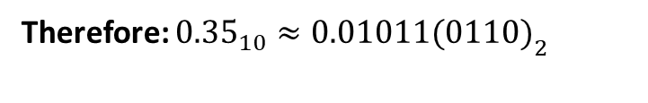
Convert a Fractional Decimal Number to Binary
Another example, $N=\text{10.35}\text{₁₀}$.
Step 2: Convert the fractional part (0.35) to binary
Step 1: Convert the integer part (10) to binary.
Step | Fraction × 2 | Integer part | Fractional part
1 | 0.35 × 2 = 0.70 | 0 | 0.70
2 | 0.70 × 2 = 1.40 | 1 | 0.40
3 | 0.40 × 2 = 0.80 | 0 | 0.80
4 | 0.80 × 2 = 1.60 | 1 | 0.60
5 | 0.60 × 2 = 1.20 | 1 | 0.20
6 | 0.20 × 2 = 0.40 | 0 | 0.40
7 | 0.40 × 2 = 0.80 | 0 | 0.80
8 | 0.80 × 2 = 1.60 | 1 | 0.60
Division | Quotient | Remainder
10 ÷ 2 | 5 | 0
5 ÷ 2 | 2 | 1
2 ÷ 2 | 1 | 0
1 ÷ 2 | 0 | 1
Integer part 10₁₀= 1010₂
You can already see it’s repeating:
The fractional parts (0.80 → 0.60 → 0.20 → 0.40 → 0.80 …)
start to cycle.
Therefore: ${0.35}_{10}≈0.01011(0110{\left.)\right.}_{2}$
Step 3: Combine both parts
Now join the integer and fractional binary parts: 10.35₁₀​≈1010.01011(0110)₂​

Slide 16
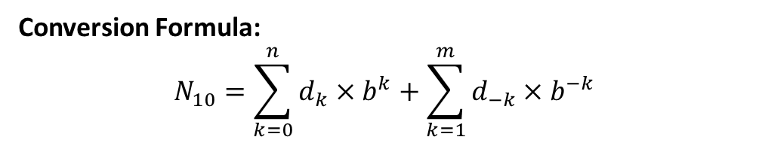
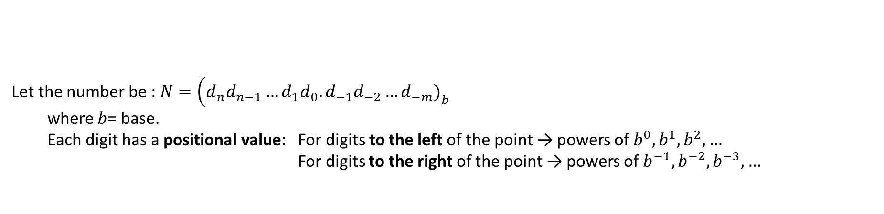
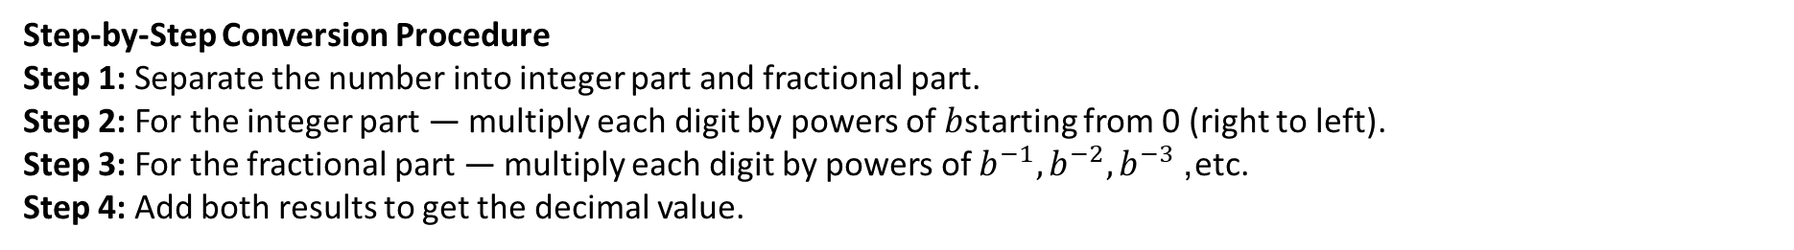
Converting Any Base Fractional Number to Decimal
Let the number be : $N=\left(d_{n}d_{n−1}…d_{1}d_{0}.d_{−1}d_{−2}…d_{−m}{\left.)\right.}_{b}\right.$
  where $b$= base.
  Each digit has a positional value: For digits to the left of the point → powers of $b^{0},b^{1},b^{2},…$
  For digits to the right of the point → powers of $b^{−1},b^{−2},b^{−3},…$
Conversion Formula:
$$N_{10}=\sum_{k=0}^{n}{d_{k}}×b^{k}+\sum_{k=1}^{m}{d_{−k}}×b^{−k}$$
Step-by-Step Conversion Procedure
Step 1: Separate the number into integer part and fractional part.
Step 2: For the integer part — multiply each digit by powers of $b$starting from 0 (right to left).
Step 3: For the fractional part — multiply each digit by powers of $b^{−1},b^{−2},b^{−3}$, etc.
Step 4: Add both results to get the decimal value.

Slide 17
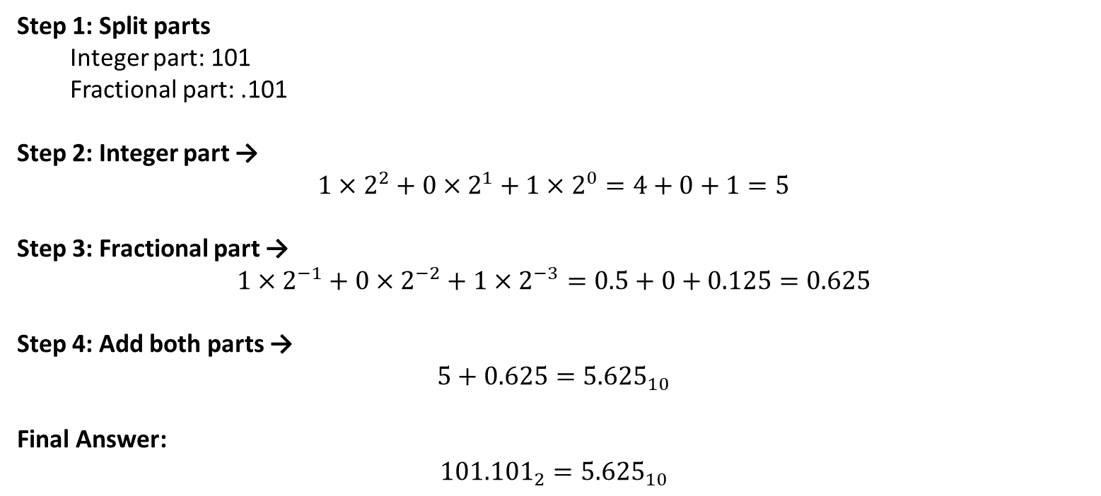
Converting Any Base Fractional Number to Decimal
Example 1: Convert ${101.101}_{2}$to decimal
Step 1: Split parts
  Integer part: 101
  Fractional part: .101
Step 2: Integer part →
$$1×2^{2}+0×2^{1}+1×2^{0}=4+0+1=5$$
Step 3: Fractional part →
$$1×2^{−1}+0×2^{−2}+1×2^{−3}=0.5+0+0.125=0.625$$
Step 4: Add both parts →
$$5+0.625={5.625}_{10}$$
Final Answer:
$${101.101}_{2}={5.625}_{10}$$

Slide 18
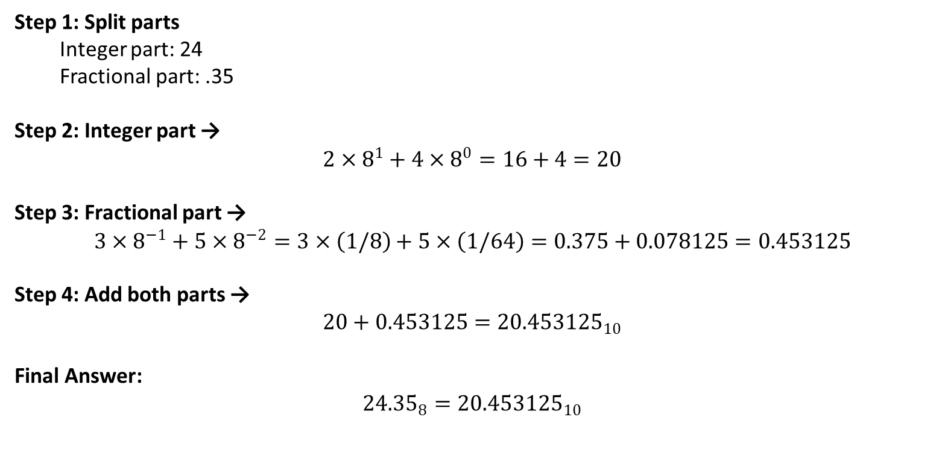
Converting Any Base Fractional Number to Decimal
Example 1: Convert ${24.35}_{8}$ to decimal
Step 1: Split parts
  Integer part: 24
  Fractional part: .35
Step 2: Integer part →
$$2×8^{1}+4×8^{0}=16+4=20$$
Step 3: Fractional part →
$$3×8^{−1}+5×8^{−2}=3×\left(1/8\right)+5×\left(1/64\right)=0.375+0.078125=0.453125$$
Step 4: Add both parts →
$$20+0.453125={20.453125}_{10}$$
Final Answer:
$${24.35}_{8}={20.453125}_{10}$$

Slide 19
Computer Codes
Computer codes are used for internal representation of data in computers
As computers use binary numbers for internal data representation, computer codes use binary coding schemes
In binary coding, every symbol that appears in the data is represented by a group of bits
The group of bits used to represent a symbol is called a byte
As most modern coding schemes use 8 bits to represent a symbol, the term byte is often used to mean a group of 8 bits
Commonly used computer codes are BCD, EBCDIC, and ASCII

Slide 20
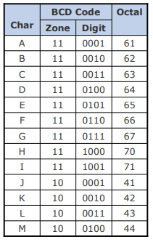
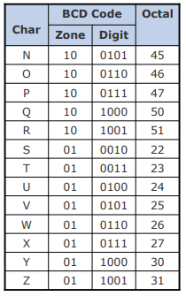
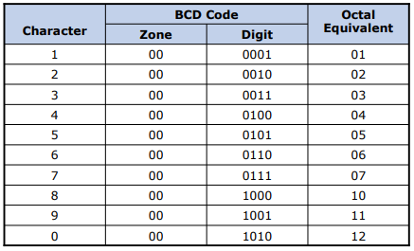
BCD Code
BCD stands for Binary Coded Decimal
It is one of the early computer codes
It uses 6 bits to represent a symbol
It can represent 64 (2⁶) different characters
The digit bits (4 bits) define values from 0000 to 1001 (i.e., 0–9).
The zone bits define the “zone” or class of character, for example:
      00 → Digits (0–9)
      10 → Uppercase letters (A–I)

Slide 21
BCD Code
Example
Show the binary digits used to record the word BASE in BCD
Solution:
B = 110010 in BCD binary notation
A = 110001 in BCD binary notation
S = 010010 in BCD binary notation
E = 110101 in BCD binary notation
So the below binary digits will record the word BASE in BCD
110010 110001 010010 110101
B A S E

Slide 22
BCD Code
Solve it
Using octal notation, show BCD coding for the word DIGIT

Slide 23
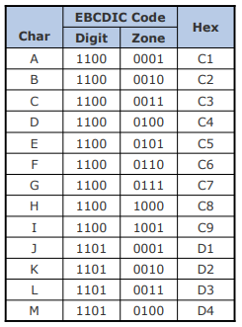
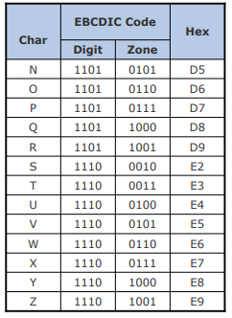


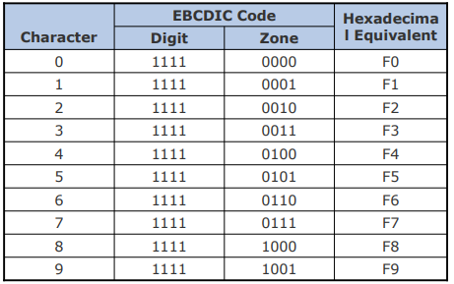



EBCDIC
EBCDIC stands for Extended Binary Coded Decimal Interchange Code
It uses 8 bits to represent a symbol
It can represent 256 (2⁸) different characters

Slide 24
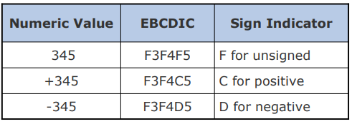
EBCDIC
Zoned Decimal Numbers
Zoned decimal numbers are used to represent numeric values (positive, negative, or unsigned) in EBCDIC
A sign indicator (C for plus, D for minus, and F for unsigned) is used in the zone position of the rightmost digit
Zones for all other digits remain as F, the zone value for numeric characters in EBCDIC
In zoned format, there is only one digit per byte

Slide 25
EBCDIC
Example
Using binary notation, write EBCDIC coding for the word BIT.
How many bytes are required for this representation?
Solution:
  B = 1100 0010 in EBCDIC binary notation
  I = 1100 1001 in EBCDIC binary notation
  T = 1110 0011 in EBCDIC binary notation
  Hence, EBCDIC coding for the word BIT in binary notation will be
  11000010 11001001 11100011
  B I T
  3 bytes will be required for this representation because each letter requires 1 byte (or 8 bits)

Slide 26
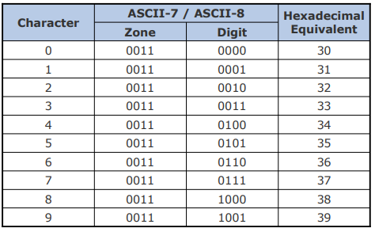
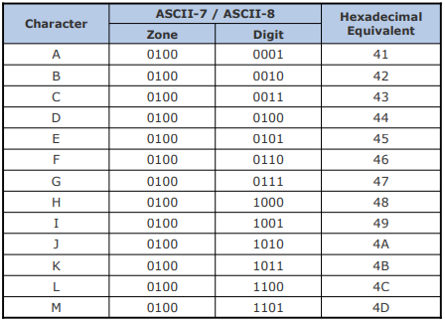
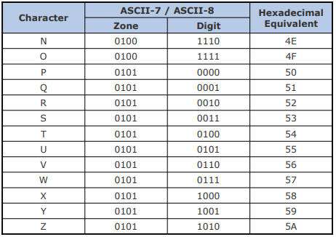
ASCII
ASCII stands for American Standard Code for Information Interchange.
ASCII is of two types – ASCII-7 and ASCII-8
ASCII-7 uses 7 bits to represent a symbol and can represent 128 (2⁷) different characters
ASCII-8 uses 8 bits to represent a symbol and can represent 256 (2⁸) different characters
First 128 characters in ASCII-7 and ASCII-8 are same

Slide 27
ASCII-8 Coding Scheme
Example
Write binary coding for the word SKY in ASCII-8. How many bytes are required for this representation?
Solution:
  S = 01010011 in ASCII-8 binary notation
  K = 01001011 in ASCII-8 binary notation
  Y = 01011001 in ASCII-8 binary notation
Hence, binary coding for the word SKY in ASCII-8 will be
01010011 01001011 01011001
S K Y
Since each character in ASCII-8 requires one byte for its representation and there are 3 characters in the word SKY, 3 bytes will be required for this representation

Slide 28
Unicode
Why Unicode:
No single encoding system supports all languages
Different encoding systems conflict
Unicode features:
Provides a consistent way of encoding multilingual plain text
Defines codes for characters used in all major languages of the world
Defines codes for special characters, mathematical symbols, technical symbols, and diacritics
Capacity to encode as many as a million characters
Assigns each character a unique numeric value and name
Reserves a part of the code space for private use
Affords simplicity and consistency of ASCII, even corresponding characters have same code
Specifies an algorithm for the presentation of text with bi-directional behavior
Encoding Forms: UTF-8, UTF-16, UTF-32

Slide 29
Sorting in EBCDIC
Example
Suppose a computer uses EBCDIC as its internal representation of characters. In which order will this computer sort the strings 23, A1, 1A?
Solution:
In EBCDIC, numeric characters are treated to be greater than alphabetic characters. Hence, in the said computer, numeric characters will be placed after alphabetic characters and the given string will be treated as:
A1 < 1A < 23
Therefore, the sorted sequence will be: A1, 1A, 23.

Slide 30
Sorting in ASCII
Example
Suppose a computer uses ASCII for its internal representation of characters. In which order will this computer sort the strings 23, A1, 1A, a2, 2a, aA, and Aa?
Solution:
In ASCII, numeric characters are treated to be less than alphabetic characters.
Hence, in the said computer, numeric characters will be placed before alphabetic characters and the given string will be treated as:
1A < 23 < 2a < A1 < Aa < a2 < aA
Therefore, the sorted sequence will be: 1A, 23, 2a, A1, Aa, a2, and aA

Slide 31
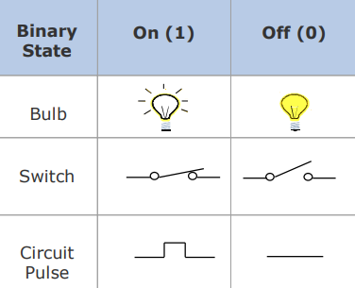
Computer Arithmetic
Information is handled in a computer by electronic/ electrical components
Electronic components operate in binary mode (can only indicate two states – on (1) or off (0)
Binary number system has only two digits (0 and 1), and is suitable for expressing two possible states
In binary system, computer circuits only have to handle two binary digits rather than ten decimal digits causing:
Simpler internal circuit design
  Less expensive
  More reliable circuits
Arithmetic rules/processes possible with binary numbers
Few Devices that work in Binary Mode

Slide 32
Binary Arithmetic
Binary arithmetic is simple to learn as binary number system has only two digits – 0 and 1
Binary Addition
Rule for binary addition is as follows:
  0 + 0 = 0
  0 + 1 = 1
  1 + 0 = 1
  1 + 1 = 0 plus a carry of 1 to next higher column
Example
Add binary numbers 10011 and 1001 in both decimal and binary form
carry
1
1
10011
+1001
Now, Add binary numbers 100111 and 11011
0
1
0
1
1

Slide 33
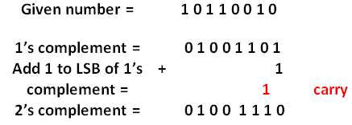
Binary Arithmetic
Binary Subtraction (using 1’s and 2’s complement method)
1’s complement of a number is found by changing all 1’s to 0’s and all 0’s to 1’s.
Ex: 1’s complement of a number 10111 is = 01000
The 2’s complement of a number is obtained by adding 1 to the LSB of 1’s complement of that number
2’s complement = 1’s complement + 1
Find 2’s complement of (101101)₂

Slide 34
Binary Arithmetic
Binary Subtraction (using 1’s complement method)
To perform subtraction (A)₂ - (B)₂
Step 1: convert number to be subtracted (B)₂ to its 1’s complement.
Step 2: Add first number (A)₂ and 1’s complement of (B)₂ using rules of binary addition.
Step 3: if final carry is 1 then add it to the result of addition obtained in step 2 to get final result.
**If final carry in step 2 is 1 then result obtained in step 2 is Positive and in its true form no conversion required.
Step 4: if final carry in step 2 is 0 then result obtained in step 2 is negative and in 1’s complement form. So convert it to its true form.

Slide 35
Binary Arithmetic
Binary Subtraction (using 1’s complement method)
Example 1: (110101)₂ – (100101)₂
Solution:
(1 1 0 1 0 1)₂ = 53₁₀₋₋₋₋₋₋₋ minuend.
(1 0 0 1 0 1)₂ = 37₁₀ – subtrahend
Now take the 1’s complement of the subtrahend and add with minuend.
1 carry
1 1 0 1 0 1
(+) 0 1 1 0 1 0
-----------------------
0 0 1 1 1 1
+ 1 carry
——————
0 1 0 0 0 0
1
Therefore, the solution is 010000
(010000)₂ = 16₁₀

Slide 36
Binary Arithmetic
Binary Subtraction (using 1’s complement method)
Example 1: (101011)₂ – (111001)₂
Solution:
Take 1’s complement of the subtrahend
1 1 1
1 0 1 0 1 1
(+) 0 0 0 1 1 0 (1’s complement of 111001)
——————
1 1 0 0 0 1
Now take the 1’s complement of the resultant since it does not carry 1
The resultant becomes 0 0 1 1 1 0 ,1’s complement of 1 1 0 0 0 1
Now, add the negative sign to the resultant value
Therefore the solution is – (001110)₂.

Slide 37
Binary Arithmetic
Binary Subtraction (using 2’s complement method)
Perform subtraction (A)₂ - (B)₂
Step 1: convert number to be subtracted (B)₂ to its 2’s complement.
Step 2: Add first number (A)₂ and 2’s complement of (B)₂ using rules of binary addition.
Step 3: if final carry is 1 then the result Positive and in its true form no conversion required.
Step 4: if final carry in step 2 is 0 then result obtained in step 2 is negative and in 2’s complement form. So convert it to its true form.
** Carry always be discarded.

Slide 38
Binary Arithmetic
Binary Subtraction (using 2’s complement method)
5 101
-7 111 1’s comple.---000
---- + 1
-2 ------
2’s complement 001
+101
-------
result 110
1’s complement 001
+ 1
--------
2’s complement 010 final result
Carry is 0 so result is negative

Slide 39
Binary Arithmetic
Binary Subtraction (using 2’s complement method)
13 1101
-10 1010 0101
------- 1
03 ---------
0110
1101
--------------
1 0011
Subtract 23 from 15 using 1’s and 2’s complement method

Slide 40
Binary Arithmetic
Binary Multiplication
Table for binary multiplication is as follows:
0 x 0 = 0
0 x 1 = 0
1 x 0 = 0
1 x 1 = 1
Example Multiply the binary numbers 1010 and 1001
Solution
1010 Multiplicand
x1001 Multiplier
1010 Partial Product
0000 Partial Product
0000 Partial Product
1010 Partial Product
1011010 Final Product

Slide 41
Binary Arithmetic
Binary Division
Table for binary multiplication is as follows:
0 ÷ 0 = Divide by zero error
0 ÷ 1 = 0
1 ÷ 0 = Divide by zero error
1 ÷ 1 = 1
As in the decimal number system (or in any other number system), division by zero is meaningless
The computer deals with this problem by raising an error condition called ‘Divide by zero’ error
Rules for Binary Division
Start from the left of the dividend
Perform a series of subtractions in which the divisor is subtracted from the dividend
If subtraction is possible, put a 1 in the quotient and subtract the divisor from the corresponding digits of the dividend
If subtraction is not possible (divisor greater than remainder), record a 0 in the quotient
Bring down the next digit to add to the remainder digits. Proceed as before in a manner similar to long division

Slide 42
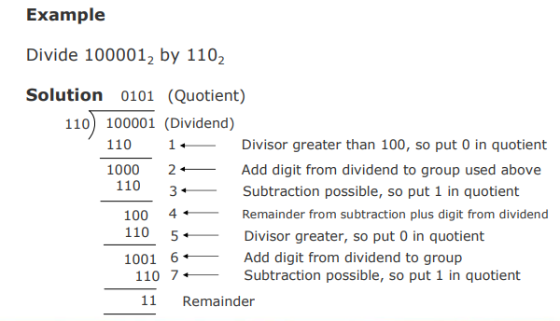
Binary Arithmetic
Binary Division

Slide 43
Boolean Algebra

Slide 44
Boolean Algebra
An algebra that deals with binary number system
George Boole (1815-1864), an English mathematician, developed it for:
  Simplifying representation
  Manipulation of propositional logic
In 1938, Claude E. Shannon proposed using Boolean algebra in design of relay switching circuits
Provides economical and straightforward approach
Used extensively in designing electronic circuits used in computers

Slide 45
Fundamental Concepts of Boolean Algebra
Use of Binary Digit
  Boolean equations can have either of two possible values, 0 and 1
Logical Addition
  Symbol ‘+’, also known as ‘OR’ operator, used for logical addition. Follows law of binary addition
Logical Multiplication
  Symbol ‘.’ , also known as ‘AND’ operator, used for logical multiplication. Follows law of binary multiplication
Complementation
  Symbol ‘-’ , also known as ‘NOT’ operator, used for complementation. Follows law of binary compliment
¬A

Slide 46
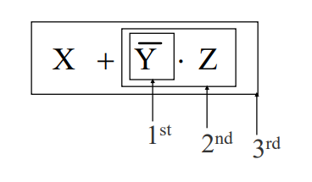
Operator Precedence
Each operator has a precedence level
Higher the operator’s precedence level, earlier it is evaluated
Expression is scanned from left to right
First, expressions enclosed within parentheses are evaluated
Then, all complement (NOT) operations are performed
Then, all ‘×’ (AND) operations are performed
Finally, all ‘+’ (OR) operations are performed

Slide 47
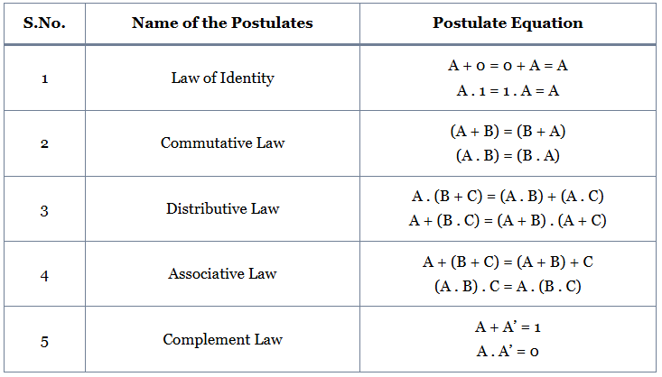
Postulates of Boolean Algebra

Slide 48
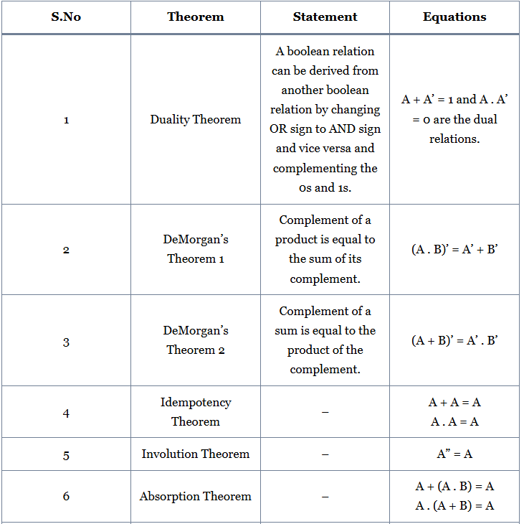
Theorems of Boolean Algebra

Slide 49
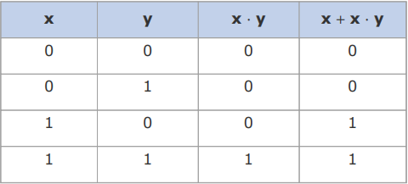
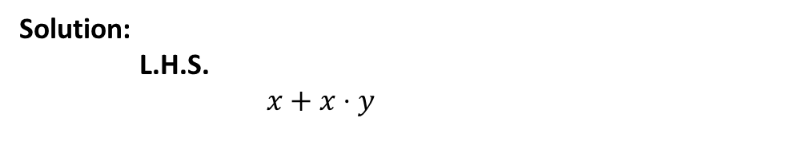
Proving a theorem by Postulates
Theorem:
x + x · y = x
Solution:
L.H.S.
$x+x⋅y$
$$=x⋅1+x⋅y \text{(}\text{postulate}\text{ : }x=x⋅1\text{)}$$
$$=x⋅\left(1+y\right) \text{(}\text{postulate}\text{: }\text{distributive} \text{law}\text{)}$$
Proof by Truth Table
$$=x⋅\left(y+1\right) \text{(}\text{postulate}\text{: }\text{commutativity} \text{of}\text{ +)}$$
$$=x⋅1 \text{(}\text{theorem}\text{: }1+y=1\text{)}$$
$$=x \text{(}\text{postulate}\text{: }x⋅1=x\text{)}$$
$$=\text{R}\text{.}\text{H}\text{.}\text{S}\text{.}$$

Slide 50
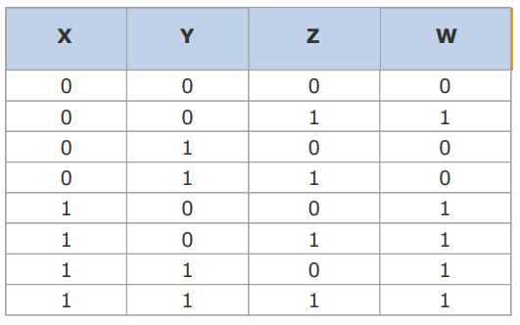

Boolean Functions
A Boolean function is an expression formed with:
  Binary variables
  Operators (OR, AND, and NOT)
  Parentheses, and equal sign
The value of a Boolean function can be either 0 or 1
A Boolean function may be represented as:
  An algebraic expression, or
  A truth table
Representation as a Truth Table
Representation as an Algebraic Expression
Variable W is a function of X, Y, and Z, can also be written as W = f (X, Y, Z)
The RHS of the equation is called an expression
The symbols X, Y, Z are the literals of the function
For a given Boolean function, there may be more than one algebraic expressions

Slide 51


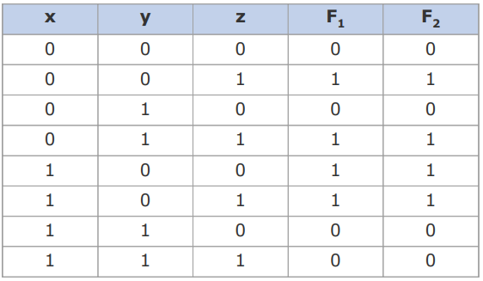
Minimization of Boolean Functions
Minimization of Boolean functions deals with
  Reduction in number of literals
  Reduction in number of terms
F1 has 3 literals (x, y, z) and 3 terms
F2 has 3 literals (x, y, z) and 2 terms
Both F1 and F2 produce the same result
F2 can be realized with fewer electronic components, resulting in a cheaper circuit

Slide 52
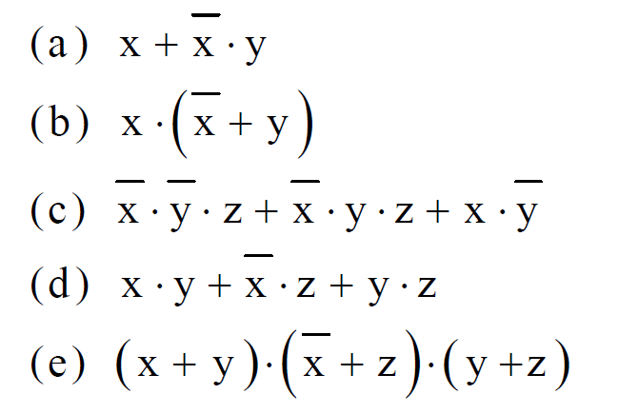
Try to Mininize (homework)

Slide 53
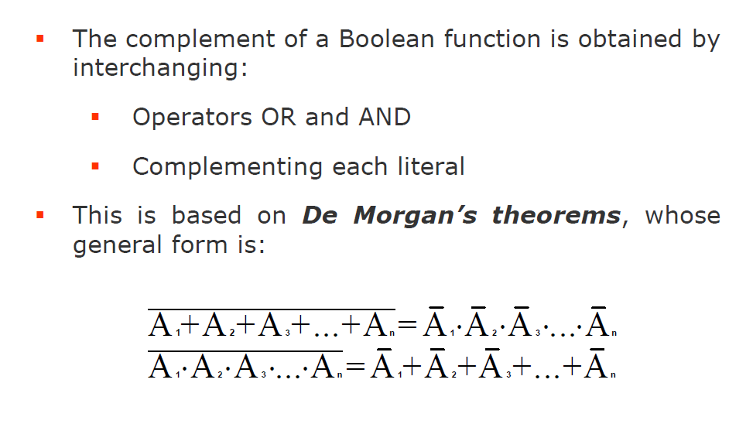
Complement of Boolean Function

Slide 54
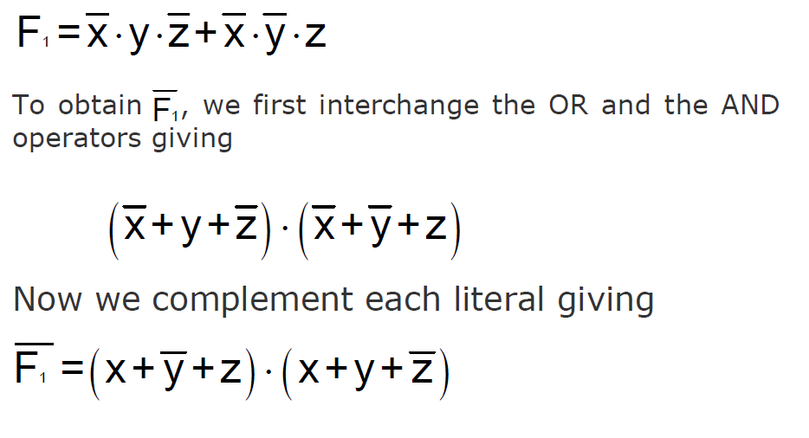
Complement of Boolean Function

Slide 55
Canonical Forms of Boolean Functions
Minterms : n variables forming an AND term, with each variable being primed or unprimed, provide 2^{n} possible combinations called minterms or standard products
Maxterms : n variables forming an OR term, with each variable being primed or unprimed, provide 2^{n} possible combinations called maxterms or standard sums

Slide 56
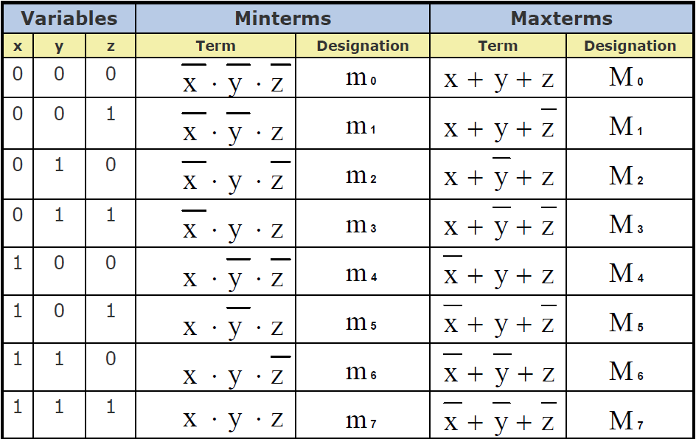
Minterms & Maxterms for Three variables…
Note that each minterm is the complement of its corresponding maxterm and vice-versa

Slide 57
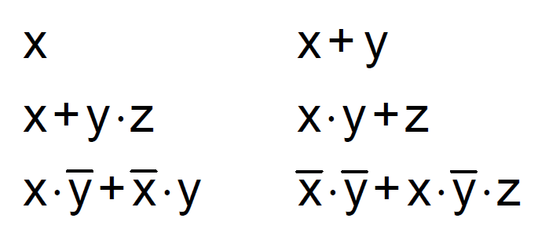
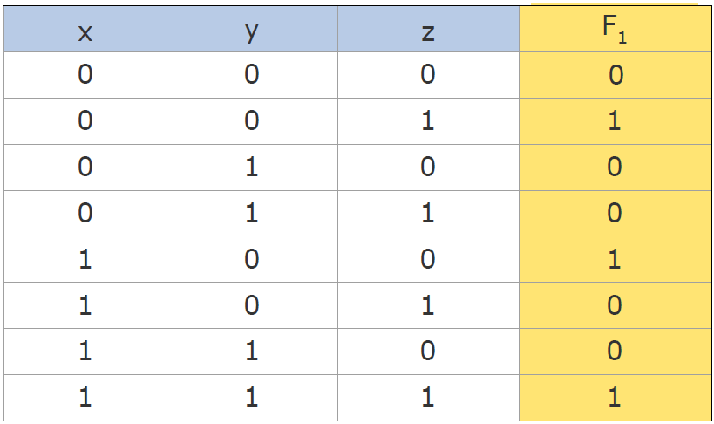

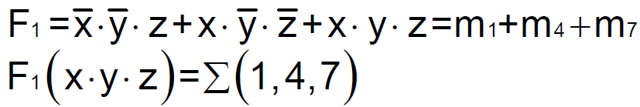
Sum of Products (SOP)
A sum-of-products (SOP) expression is a product term (minterm) or several product terms (minterms) logically added (ORed) together. Examples are:
Steps to Express a boolen function in its SOP:
1. Construct a truth table for the given Boolean
function
2. Form a minterm for each combination of the
variables, which produces a 1 in the function
3. The desired expression is the sum (OR) of all the minterms obtained in Step 2
The following 3 combinations of the variables produce a 1: 001, 100, and 111
Expressing a Function in its
Sum-of-Products Form (Examp
Corresponding minterms are:
Taking the OR of these minterms, we get

Slide 58
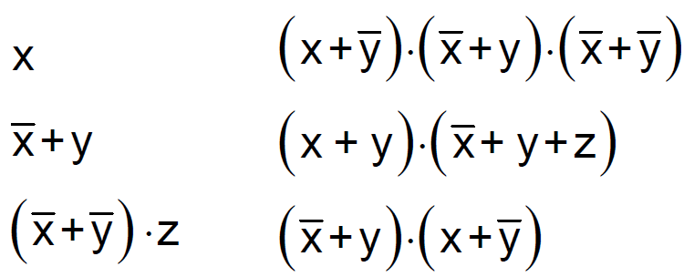
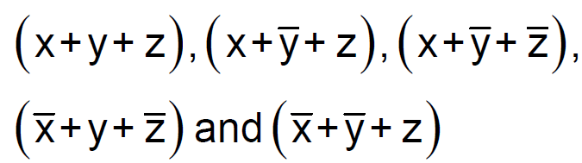
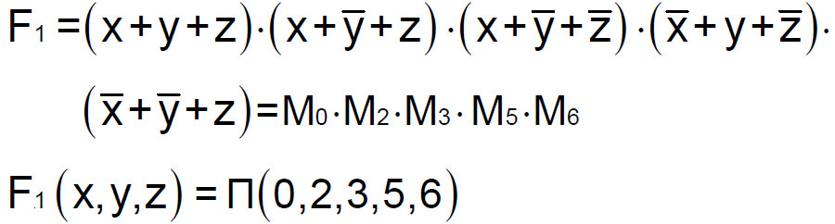
Products of Sum(POS)
A product-of-sums (POS) expression is a sum term (maxterm) or several sum terms (maxterms) logically multiplied (ANDed) together. Examples are:
The following 5 combinations of the variables produce a 0: 000, 010, 011, 101, and 110 Expressing a Function in its
Sum-of-Products Form (Examp
Steps to Express a boolen function in its POS:
1. Construct a truth table for the given Boolean
function
2. Form a maxterm for each combination of the
variables, which produces a 0 in the function
3. The desired expression is the product (AND) of all the maxterms obtained in Step 2
Corresponding maxterms are:
Taking the OR of these maxterms, we get

Slide 59
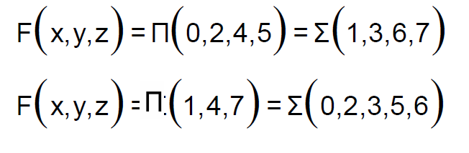
SOP POS
To convert from one canonical form to another, interchange the symbol and list those numbers missing from the original form.
Example:

Slide 60
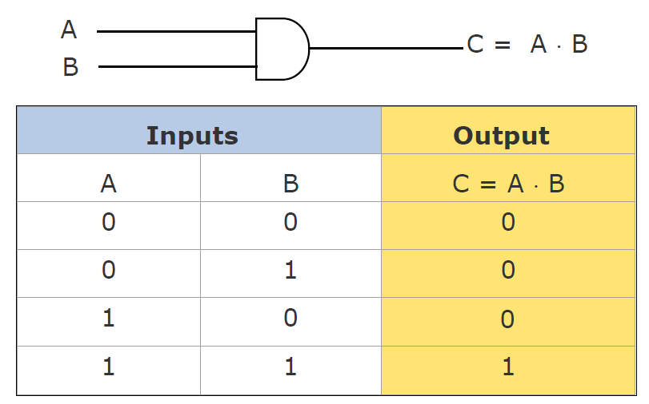
Logic gates
Logic gates are electronic circuits that operate on one or more input signals to produce standard output signal
Are the building blocks of all the circuits in a computer
Some of the most basic and useful logic gates are AND, OR, NOT, NAND and NOR gates
AND Gate
Physical realization of logical multiplication (AND) operation
Generates an output signal of 1 only if all input signals are also 1

Slide 61
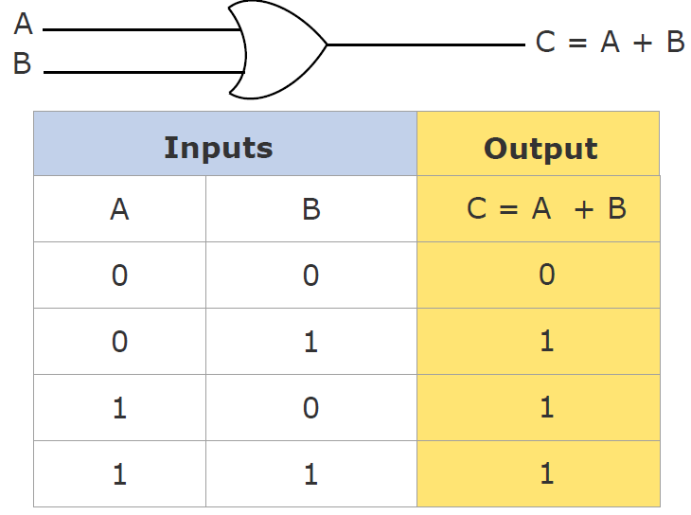
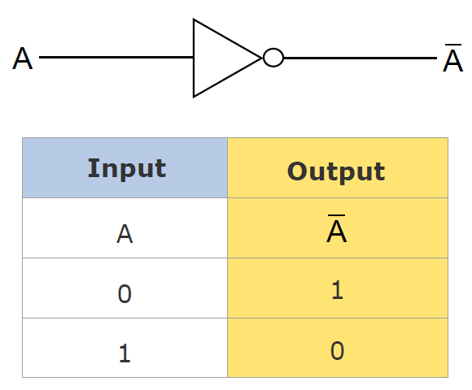
Logic gates
OR Gate
NOT Gate
Physical realization of logical addition (OR) operation
Generates an output signal of 1 if at least one of the input signals is also 1
Physical realization of complementation operation
Generates an output signal, which is the reverse of the input signal

Slide 62
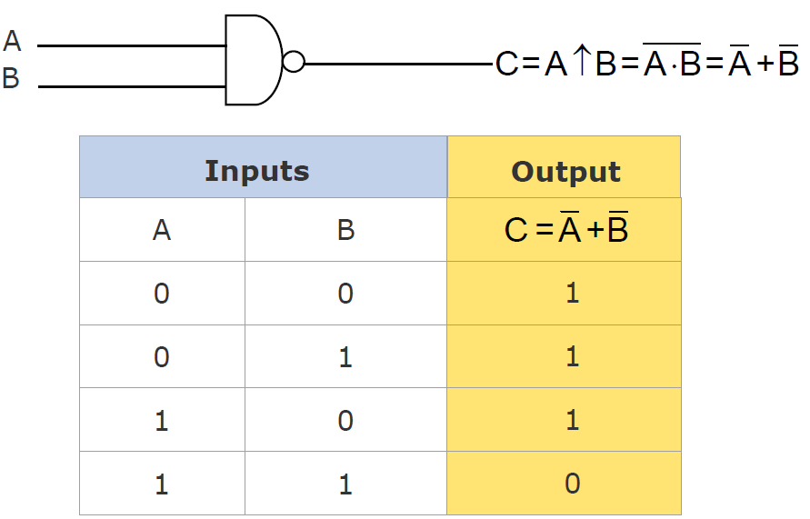
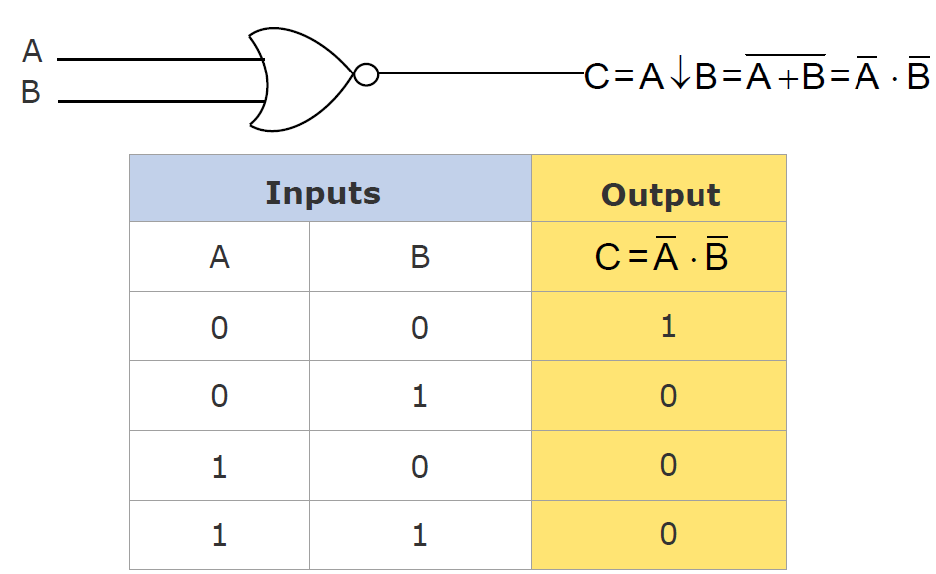
Logic gates
NAND Gate
NOR Gate
Complement of AND Gate
1 if any one of the inputs is a 0
0 when all the inputs are 1
Complement of AND Gate
1 only when all inputs are 0
0 if any one of inputs is a 1

Slide 63
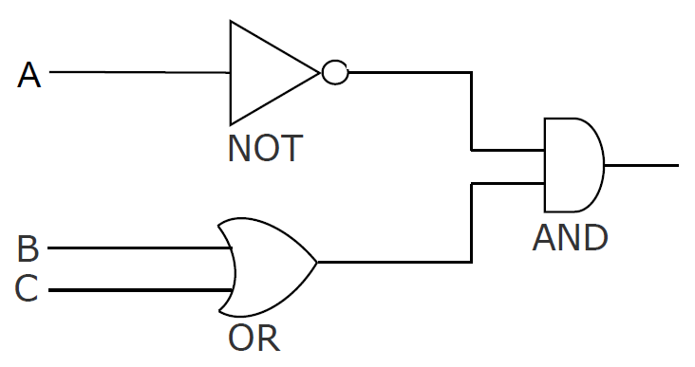
Logic Circuits
When logic gates are interconnected to form a gating / logic network, it is known as a combinational logic circuit
The Boolean algebra expression for a given logic circuit can be derived by systematically progressing from input to output on the gates
The three logic gates (AND, OR, and NOT) are logically complete because any Boolean expression can be realized as a logic circuit using only these three gates

Slide 64



Finding a Boolean expression of logic circuit

Slide 65
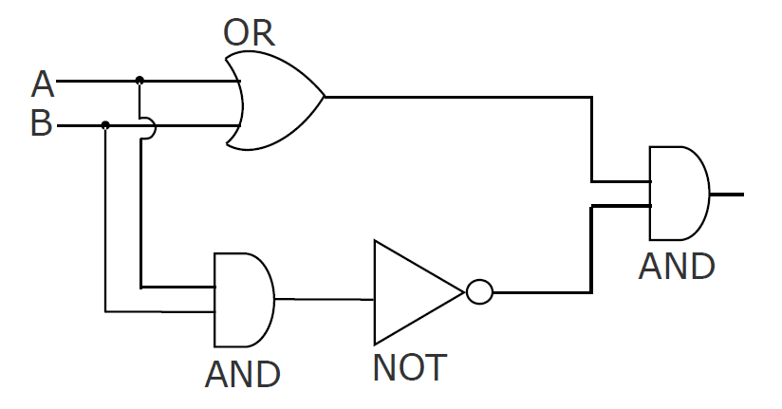




Finding a Boolean expression of logic circuit

Slide 66


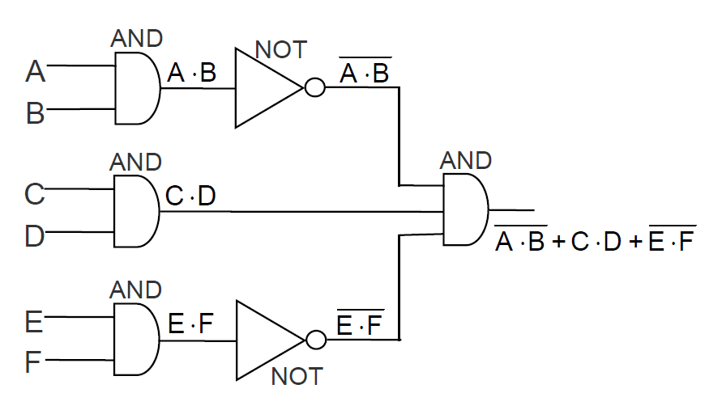
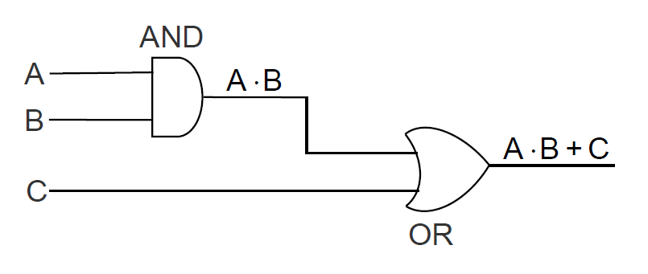
Logic Circuit from Boolean Expression
Boolean Expression:

Slide 67
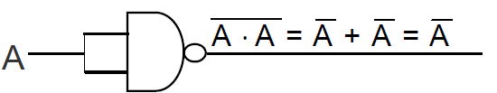


Universal NAND gate
NAND gate is an universal gate, it is alone sufficient to implement any Boolean expression
To understand this, consider:
  Basic logic gates (AND, OR, and NOT) are logically complete
  Sufficient to show that AND, OR, and NOT gates can be implemented with NAND gates
NOT
AND
OR

Slide 68

Only with NAND gates
Step 1: From the given algebraic expression, draw the logic diagram with AND, OR, and NOT gates. Assume that both the normal (A) and complement ( ) inputs are available
Step 2: Draw a second logic diagram with the equivalent NAND logic substituted for each AND, OR, and NOT gate
Step 3: Remove all pairs of cascaded inverters from the diagram as double inversion does not perform any logical function. Also remove inverters connected to single external inputs and complement the corresponding input variable

Slide 69


Only with NAND gates
Boolean Expression
Step 1: AND/OR implementation

Slide 70

Only with NAND gates
Boolean Expression
Step 2: Substituting equivalent NAND functions

Slide 71

Only with NAND gates
Boolean Expression
Step 3: NAND implementation

Slide 72



Universal NOR gate
NOR gate is an universal gate, it is alone sufficient to implement any Boolean expression
To understand this, consider:
  Basic logic gates (AND, OR, and NOT) are logically complete
  Sufficient to show that AND, OR, and NOT gates can be implemented with NAND gates
NOT
OR
AND

Slide 73

Only with NOR gates

Slide 74

Only with NOR gates

Slide 75


Only with NOR gates

Slide 76

Only with NOR gates

